Slide 1

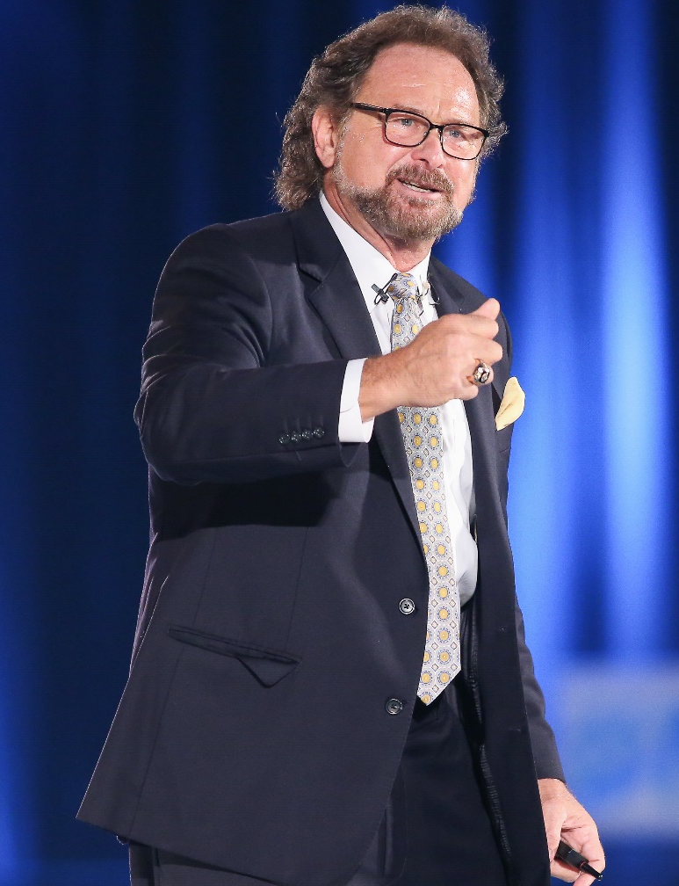
2019美安台灣區域大會
Dennis Franks
范丹毅
美安集團SHOP.COM 執行副總裁
資深執行副總裁級超連鎖®店主
每四週佣金收入NT$1,995,000~NT$2,535,999

Slide 2

BASIC
Overview

Slide 3
Shopping Annuity
Develop Customers
Product Brokerage
Mall without Walls
SHOP.COM
BV
RESIDUAL INCOME
MPCP
IBV
Information & Internet
Unfranchise System
Information
Transparent Customization Surveys, Digital Marketing
Preferred Customers
Customers
One-to-One Marketing
Build Share of Customer
Work with Best Customers

Slide 4
ATTITUDE and KNOWLEDGE
The Business of Belief
Create Your Future
Business or Hobby (Part Time not Spare Time)
Market-Driven Products
Strategic Advantages
Unfranchise Management System (UFMS)
Global Meeting Training Seminar System (GMTSS)
The Formula...
Notes:
4
4
4

Slide 5

THE FORMULA
TIME^{Q} = GROWTH^{D}= VOLUME(BV&IBV) = MONEY $$$
QUALITY TIME
time spent with “GO NOW” UFOs.
GROWTH through duplication of “GO NOW” UFOs.
IF YOU DON’T HAVE ANY “GO NOW” PEOPLE, GO FIND SOME!!

Slide 6

Give a lecture to a thousand people...
“I’m going to change my life”.
“I’ve heard all this before”.
One walks out and say...
Another walks out with a yawn and says...
Why is that? Why wouldn’t both be affected the same way?

Slide 7
GOAL SETTING
If you aim at nothing, you will hit it.
The “Why”...Your Purpose... Your Vision...
Writing The Goal Statement
Writing The Action Plan to Meet the Goal
  Daily, Weekly, and Monthly Goals
Measure, Monitor, Adjust and Control
Small, Intermediate, and Long
Notes:
7
7
7

Slide 8
RETAILING
Create Positive Cash Flow
Repeat Customer Base – (Base 10)
Prepare to Retail
Product of the Product / Shopping Assessment
Be a Problem Solver –Solutions Oriented
Make The Close
Build Share of Customer
Regenerate BV
Shopping Annuity
Notes:
8
8
8

Slide 9
PROSPECTING
RECRUITING
SPONSORING
This is a process… Ask Qualifying Questions
Notes:
45 or 2-3 year, do you believe that multiple streams of income are important, can you save money by shopping on line, what is your time worth?

Slide 10
PROSPECTING (ENGAGE)
Need a List - 100-300 Names
Need an Approach
Asking Questions and Building Relationships
Need Follow-up Materials
Need to Dialogue
  What do you do?
  Two-minute Commercial
  Themes
  Booking the Appointment
  Follow up
Notes:
10
10
10

Slide 11
RECRUITING (Enlighten & Educate)
The Appointment
  The Volley
  The Plan
  The Getting Started Guide
Book The Follow Up
The Tools
Follow Through - (Communicate )
Make The Close
  Trial Run & ABC Pattern
  Sponsorship & ABC Pattern
Notes:
11
11
11

Slide 12
Put some
in your RECRUITING and take action!
VITAMIN E

Slide 13

Engage

Slide 14

Enlighten

Slide 15

Educate

Slide 16

Energize

Slide 17

Empower

Slide 18
SPONSORING (Empower)
Book The Follow-up Appointment
  Getting Started Guide
  The NUOT Tracker or Modification
  Set up the Website Administration and UFMS and Support Materials.
  Schedule the NUOT & Basic 5
Review the Getting Started Guide
Sign Up Wizard or Send Partner Now
Teach “The Power is in the Structure”
Notes:
18
18
18

Slide 19
Follow Up & ABC Pattern of Building Depth
Getting Started Guide
Be Accountable
Work with your Personally Sponsored
Support your Organization
Assist “Go Now” UFOs their first three (3) levels
The Master Unfranchise Program
Notes:
19
19
19

Slide 20
ABC Pattern of Duplication & Building Depth
SENIOR PARTNER
YOU
A
A
B
B
C
C
A1
A1
B1
B1
C1
C1
A, B, C, etc. are “Go NOW” Distributors

Slide 21
The ABC Pattern Gives You CONTROL OVER YOUR...
Success
Growth
Progress
Timing
It takes the chance out of it!
Notes:
21
21
21

Slide 22
Implement the Basic 5 DAILY...like breathing!
Notes:
22
22
22

Slide 23
SUCCESS is neither magical nor mysterious. SUCCESS is the natural consequence of consistently applying basic fundamentals.

Slide 24
BASIC
Overview

Slide 25

BECOME
A DIRECTOR
Learn The Logic Behind Recruiting

Slide 26

Be a Solutions Provider
Ask probing questions
Listen more than talk
Look to understand the need
  Develop your own philosophy
Speak to enough people
Examine the results and adjust, if necessary to make measurable progress
Be a giver and not a taker

Slide 27
Attitude and Knowledge
Goals
Retailing
Prospecting, Recruiting, Sponsoring
Follow Up and The ABC Pattern of Duplication
THE
BASIC 5

Slide 28

Never Been a Better Time
People are living longer and outliving their savings
People not saving enough
People need emergency cash
Higher Costs
  Health Care
  Education
  Increased Food and Energy Costs

Slide 29

Times Are Changing
  45 year plan is not working
  Awareness to multiple streams of income
  Todays dollars buy less
People will be more receptive because they have been looking...

Slide 30

The Logic of Recruiting
Fill the Funnel…starts with the list of 100-300 names
Master the Approach - You are not selling but sharing information and options
Build the Relationship - Don’t be weird
Find the Bridge - (commonalities / the pain...your two-minute commercial)

Slide 31
The Logic of Recruiting
Bring them Across...show you care & offer a solution - (this is done through effective listening)
Qualify the Candidate - (connected, beliefs, communication skills, have goals)
Show the Plan - not too much, address the questions
Book the Follow up Appointment - (Three Way Call or Skype) and get them on a product

Slide 32
The Logic of Recruiting
9. Book to the Trial Run, HBP or UBP
10. Sell a Ticket – Basic 5, Local, District, Regional, Corporate Event, Specialty Trainings
11. Validate Solution - (review plan of action to meet goal and get agreement)
12. Trial Run / Close to Registration

Slide 33

THE MISSING LINK
EXECUTION
THE DISCIPLINE OF GETTING THINGS DONE!
PRACTICE, PRACTICE, PRACTICE
REPETITION AND CONSISTENCY
Limit the Missed Assignments

Slide 34

Execution
An Action to Reach “Competitive Greatness”
Implementing with Skill, Timeliness and Get Results
Meeting the Desired Outcome
The Discipline of Integrating Strategy with Reality
Aligning People with Goals and Achieving Results

Slide 35

The absence of EXECUTION and follow up are the two biggest reasons why Unfranchise® Owners fail to accomplish their goals.

Slide 36

Why Don’t Unfranchise Owners Execute Efficiently
Lack of Knowledge & Fundamentals
Lack of Preparation
Not Taking Action
Not a Priority
Not Enough Repetitions
Lack of Mentorship
Lack of Discipline

Slide 37
How Do I Execute Better
Winning Mindset
Learn the Fundamentals - become the ultimate student
Prepare
Make Execution a Priority
Get the Repetitions
Determination
Continue to Measure and Adjust

Slide 38

To Execute As
A Professional
need...
A Plan
A Commitment
Follow Through
Accountability
Follow Through

Slide 39

Execution Can
Not Be Delegated
Leaders who execute provide the road map for teams to follow!

Slide 40
Market America UnFranchise® Business
NUOT, Basic 5, ECCT - (Repeat and Master)
University Major Trainings / Specialty Trainings
Results Producing Activities
Base 10, Seven Strong
Becoming a Master UFO
Requalifying as a Master UFO
Becoming a Shopping Annuity Master Member
Execution gets the Results!
Notes:
40

Slide 41

When you execute your results producing activities, you will enjoy a success rate that propels you top the top of your game.

Slide 42

BECOME A DIRECTOR
Learn The Logic
Behind Recruiting

Slide 43

For a first appointment
MECHANICS

Slide 44
Prepare With The Right Tools
Getting Started Guide
MPCP Flip Chart
Smart Hone, Tablet, Laptop, UFMS and Product Major Sites
Pen / Marker and Paper
Home Shopping List
Product Catalog
Corporate Brochure

Slide 45
Visualize the outcome before-hand and set your self to a positive mindset.
Remember, you are looking to book the follow up appointment and continue the relationship.
Visualize yourself registering a new business partner or a new customer.

Slide 46
The Appointment Begins
Small talk – (family, occupation, recreation)
Overview of the one hour, confirm ending time
Before we get started take a minute or two and complete this Home Shopping List

Slide 47
Opening 3-5 Minutes
Welcome and gratitude for taking time
Time is precious, but confident it will be time well spent
Your “Two-minute Commercial and Why”...you can start.
  You are probably wondering why I wanted to speak to you today. after working for so many years, I finally realized...something or someone had to make some changes for things to change. I began searching. I found...

Slide 48
Why You Chose An Unfranchise Business
Based on popularity of entrepreneurism, advancement of mobile technology, the huge demand for people to buy (distribution) and online shopping, the timing was right to take a piece of that market.

Slide 49
Go For A Tour Of Your Business Location
Brief overview of your Shop.com site
Highlight the home page and the many menu items
Share the Preferred Customer Cashback incentive and the stream of daily deals (simply go to the store’s menu item. Go through the options; free shipping, one-cart, in store pick up)

Slide 50
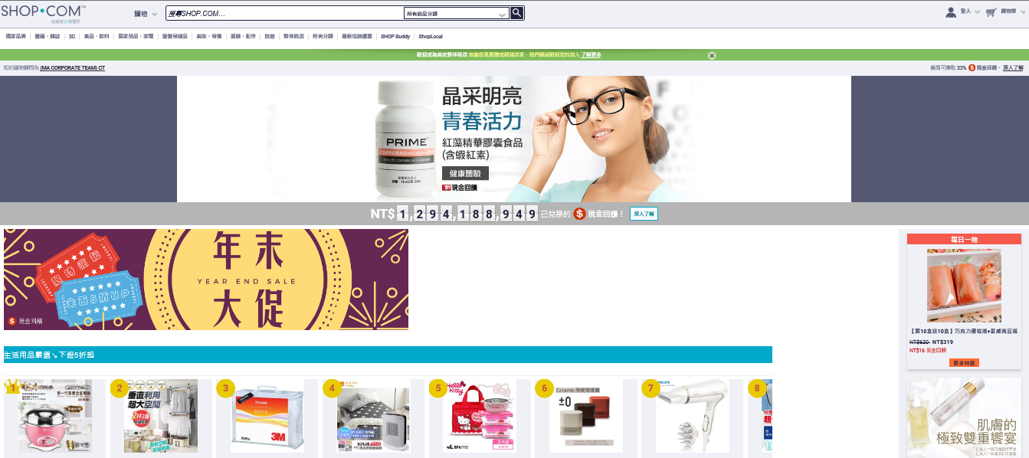
Taiwan TW.SHOP.COM Site

Slide 51
Go For A Tour Of Your Business Location
Highlight the many affiliate stores - (your favorite stores)
Highlight the exclusive brands and be sure to speak of the quality, demand, strong value and the fact we make the highest retail profit and commissionable income from MA Brands
Online sites create many opportunities to earn, mention the Shopping Annuity and concept

Slide 52
Unfranchise Business Owners Are Profitable
Share some of your favorite success stories
Ask...before I show you how an Unfranchise Owner earns, let’s assume this works for you.
What amount of money, in addition to what you earn, would put you where you would like to be financially on a monthly basis?
A realistic number that would put you and your family in the lifestyle that you would like to provide.

Slide 53
Unfranchise Business Owners Are Profitable
In most cases, your prospect will give you a number, usually somewhere in between $1,000-$10,000 a month more
Your response...”the good news is we have many UFOs that earn that type of additional, residual income. Would you be happy to make this happen over the next 60 months”
I can send you some of their profiles and you can check them out.
Ask...”what will you do with the extra income”
Follow up with...”how will that make you feel”

Slide 54
The Key Take-Aways
Find out the additional monthly amount
Why they want it
When they want it
How it will make them feel
These answers will support the attendance of a follow-up meeting or invitation to an UBP.

Slide 55
Move To The Five Steps Of Earning In The MPCP
Apply
Create
Qualify
Activate
Teach, Manage and Support
(Review the criteria of the pay plan)

Slide 56
Remember To Comment
During the plan presentation of the pay criteria, there is a slide/page that illustrates the Base 10, Seven Strong. Take a note and share that this is the “microcosm” of becoming very successful

Slide 57
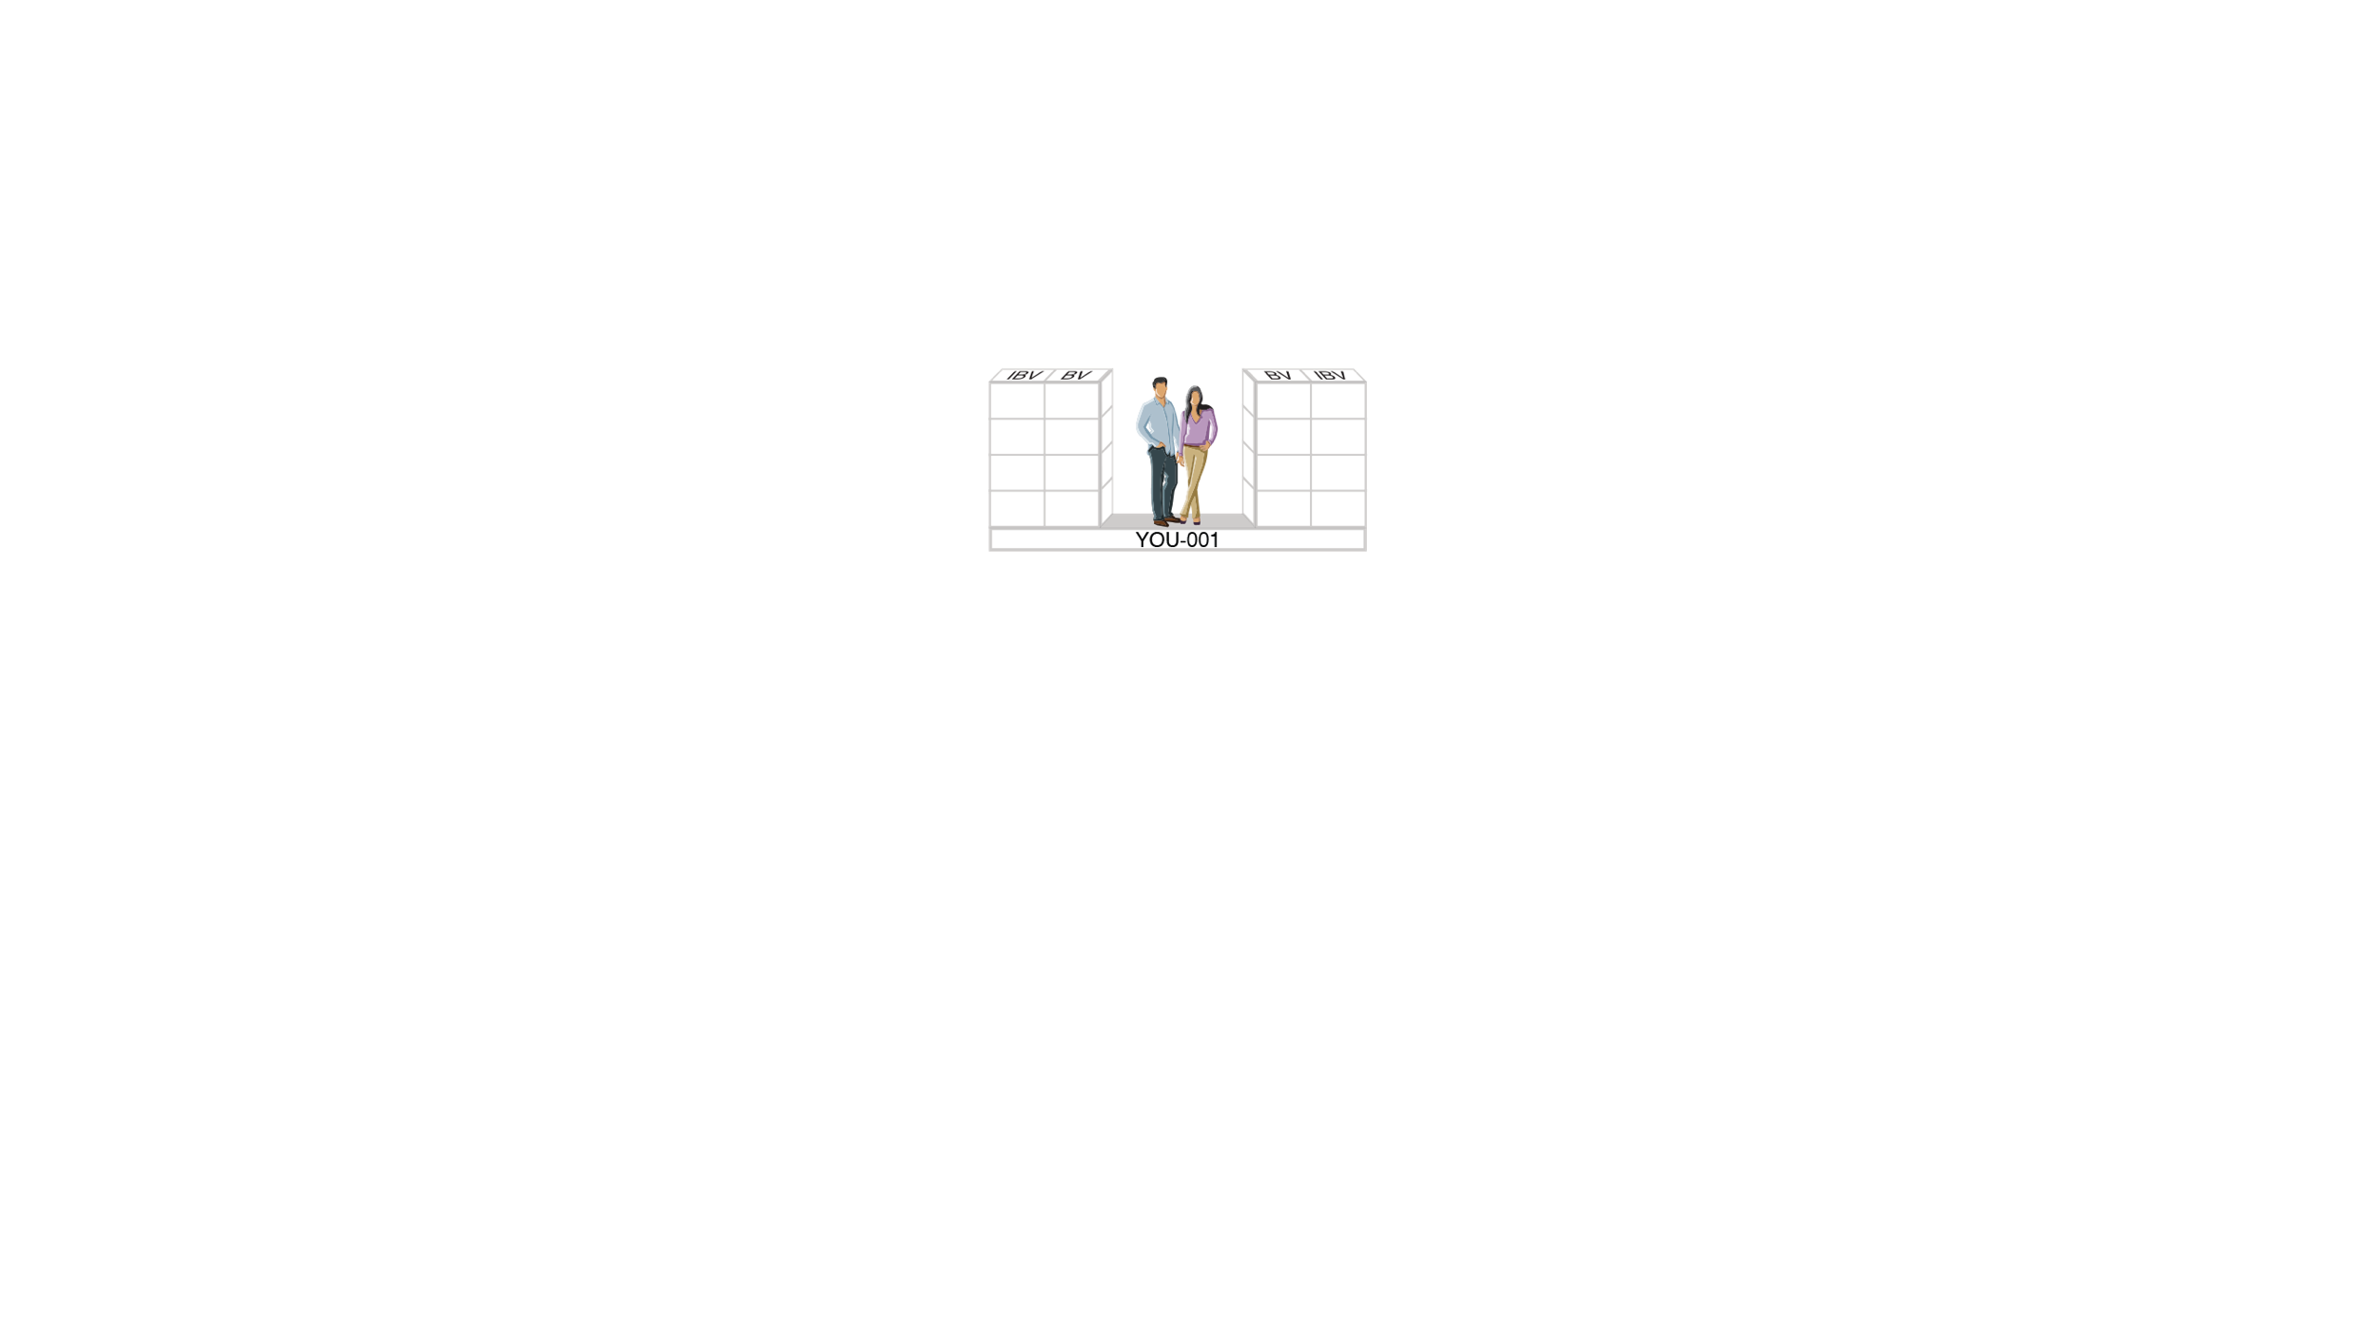






STEP 5 – TEACH, MANAGE AND SUPPORT OTHERS
1. APPLY
2. CREATE
3. QUALIFY
4. ACTIVATE

Slide 58
Remember To Comment
Whatever the desired additional income stated by the prospect, stop at the amount. Do not sell more than the prospect wants at the first appointment.
Ask...”can you see how the monthly income can be achieved and maintained through this process”

Slide 59
The Getting Started Guide
Have Page One completed prior to the appointment.
Review Page Two – talk through the first 7 “I Will” statements. These are a minimum requirement for success.

Slide 60
The Getting Started Guide
Have the training dates already entered.
Assign homework of “write out 30 names, mobile phone numbers and email addresses of people that are 10 in health and wellness, 10 in beauty and age management, and 10 that want to earn more income”. Write them on Page 9.

Slide 61
Finish Strong
What did you like best about what you were introduced to today?
You are probably thinking of 2-3 people...
I know it was a lot. So, I have additional information that I will send you electronically.
Let’s set a follow up and maybe you can invite those 2-3 people to review the business.

Slide 62
Booking The Follow Up Appointment Know Your Options
1 on 1 Follow Up
2 on 1 Follow Up – (in person or online or on phone)
Trial Run
HBP
UBP
Local Seminar, District, Regional, or Major – (these are your choices. You must have a ticket in hand)
Basic 5

Slide 63
After Booking The Follow Up Appointment
Sell a Product
Three-day Trial Size Marketing
Any MA Branded Product would work, based on their interest

Slide 64
For a first appointment
MECHANICS

Slide 65

NO TIME
IS MORE IMPORTANT
THAN RIGHT NOW

Slide 66
Unprecedented Exponential Change and Progress
Linear Growth of 1-30 verse Exponential Growth of 1-30
Total 465
Exceeds a Billion

Slide 67
The 21st Century discoveries and learning compares to the first 20 Centuries of discoveries and learning.
1 Year Today equals 100 Years of Progress

Slide 68

RAY KURZWEIL
American Inventor and Futurist
Winner of the National Medal of Innovation Technology
Field of Expertise
  Optical Character Recognition (OCR)
  Text to Speech Synthesis
  Artificial Intelligence (AI)
  Nano Technologies
“Change is so rapid and profound, it represents a rapture in the fabric of human history”

Slide 69

WE MUST BE AWARE...

Slide 70
The Internet Evolution...
500 Million Devices Connected to the Internet
35 Billion Devices Connected to the Internet
50 Billion Devices Connected to the Internet
1 Trillion Devices Will Connect to the Internet
2013
2018
2020
2030

Slide 71

THREE Radical Changes in Our Time

Slide 72

1
Culture is changing due to:
Prosperity and safety
Women in the labor force is increasing
Men in the labor force is decreasing
Today 20% of men are stay at home dads. Source: Virginia Tech, US Bureau of Labor

Slide 73

Women Have An
Increasing Advantage
40% of the women out earn husbands
Women influence 85% of all purchases
Communitarians
Build better relationships
Women are better to achieve selected goals

Slide 74
Women Have An
Increasing Advantage
Purchase 50% of products related to men
Better primary care givers
Pass along information better
Will be the biggest growth market over the next decade

Slide 75

2
35% of the labor force are Millennials
  87 million as compared to 53 million Gen X
    (Age 39-35)
  41 million Baby Boomers
    (Born 1946 – 1964)
Leadership must evolve to meet the change
Demographics Are Changing

Slide 76

THE NEW INSANITY
Doing the same thing and expecting the same results.
CHANGE
is happening daily!

Slide 77

  PEOPLE
  need to understand...
The 45-year plan is not working
Multiple streams of income is smart
Owning your own business is a good choice
Technology is not going away

Slide 78

Age of the CONSUMER is here...
Recognize the Consumer has unlimited options
Consumers can get immediate comparisons
Little to no loyalty
Zero patience with high expectations

Slide 79

  CONSUMERS
  are key influencers
Customer OPINION Matters
Customer REVIEWS Matter
Customer SATISFACTION Matters

Slide 80

The Market America Network Effect (Tracking System) changes everything and there has never been a better time to be an ENTREPRENEUR and an UNFRANCHISE OWNER.

Slide 81
UFOs and PREFERRED CUSTOMERS...
Take the time to write reviews on MA Branded Products
70% of customers look to customer reviews as the number one source when deciding which brands and products to buy
88% of customers trust reviews
Reviews by strangers are equal to family

Slide 82

THE MARKETING STATEMENT
The time is now to leverage the new consumer, being more aware of their needs and potential in retraining them to “change the way they shop” by “converting their spending into earning”, and be a part of “creating the economy of the future”.

Slide 83
Market America MPCP + The Shopping Annuity
Become an Unfranchise Business Owner and build “residual income”
Create a Shopping Annuity leveraging the Unfranchise business organization and Shop.com

Slide 84
Sales and Marketing
Build an Unfranchise Business
Selling (sales) is being face-to-face with one or more people to sell a MA Branded Product or the Business
Marketing is getting an audience of people in front of you so you can sell a MA Branded Product or Business

Slide 85

SIX STRATEGIES
for building a strong organization...

Slide 86

1.
Have a higher purpose...create a VISION for your team.

Slide 87

The Vision...
“ To identify and lead Entrepreneurs to wealth through residual income becoming part of the 5% who make it to financial security.”

Slide 88
Have A Higher Purpose...The Next Level
Be The Mission Within The Company
Change An Industry
Change The Way People Shop
Convert Spending Into Earning
Make The Shopping Annuity A Reality

Slide 89
Have A Higher Purpose...The Next Level
Market America originally was created to change an industry...where if you followed a proven plan, an average person could mean an above average income.
Market America is going to “change the way people shop “to covert spending into earning fueling the Shopping Annuity”

Slide 90
Vison + Mission...
The Power of Pull
Creating the purpose so inspiring that your team becomes an advocate/ evangelist
Everybody deep down wants to be a part of something
Market America and UFOs are a community of entrepreneurs
Be the Best Entrepreneur/Unfranchise Owner
Creating the Economy of the Future
PEOPLE WORKING TOGETHER

Slide 91

When consumers are given a choice between two product of equivalent price and quality...
78% buy products associated with a cause
66% switch brands
61% will switch retailers
66% will pay a higher price
By Cone/Roper Cause-Related Trend Reports

Slide 92

Find a Social Consciousness and
TAKE A STAND
Having a point of view is better than being tolerated or being ignored.
Use extreme emotions...identify a common enemy like “lack of money” and “lack of opportunity.
You do not have to be normal. Do not let someone dictate what you do. Take action and grow.

Slide 93

Are you your own worst enemy?
You don’t earn $200,00 a year being on the internet 2 hours a day!
Build on a common distraction, having a visible opponent is a unifying force. This will elevate the collective purpose.

Slide 94




COMMON
DISTRACTIONS
Social Media Addiction
Little To No Money, No Savings
Too Much Debt
Lack of Opportunity

Slide 95

State Your
“Rally Cry”
Rally Cry can be “break status quo”, residual income, time freedom, convert spending into earning. Live your purpose. Everything changes today!

Slide 96

2.
Beat The Drum
Raise the teams level of awareness
Recognize your team members
INSPIRE them
CHALLENGE them
BELIEVE in them
Notes:
Beat the Dream “Build the following”
-Raise the Team’s level of Awareness
Average people are making it to the million dollar club and so can you..
-Recognize them
-Inspire Them
Our Stand: “It stops today, and it begins today
Break Status Quo, Create Residual Income, have
Time Freedom and convert spending into earning!
-Challenge them …Become a Master UFO
-Believe in them…You have the Ability, so much more than you know

Slide 97

Swagger
Feel Special
Sell the Status
“When I eat, drive, wear, use MA Products, I am purpose-driven”
Build Communities
3.

Slide 98

Show that you understand the pain, frustration, hope and aspirations
Feel, felt, found
Be empathetic...I understand how you feel
Nobody should have to experience...
Like you, we are frustrated
We care about your...
Aikido
4.

Slide 99

Be the authority.
You will be a most trusted advisor.
You understand and you have the solutions.
People want clarity, simplicity and certainty. We offer it all.
Humans connect with humans. Put a face on your business.
People buy into people and the community.
The Guru
5.
Notes:
Be the Guru…
What are you selling? You!
Humans connect to Humans… Put a face to your business.
People buy into the community…The GMTSS represents our community
You are an authority, and will be a most trusted adviser to your team
Know people want clarity, simplicity and certainty. You understand that and have the solutions.

Slide 100

Create a Love Fest
6.
Love bombing...new members get more love than established ones.
Make people feel special
Key points of essential human needs
Belong (create a community/team)
Make Meaning (having a purpose and be significant)
Feel Secure
Order in Chaos (Rules and Structure are needed)
Notes:
Create a Lovefest
“Love Bombing” … new members get more love.
( find a face book page that welcomes a new UFO to the team. Should be on my team paragon facebook page)
Make people feel special and the transition into the team Ideology and belief will happen
Essential human needs include
Belonging only second to food and shelter
Have meaning, a purpose or significance
Feel secure
Structure, or rules, certainty, “an order to the chaos”

Slide 101

ORGANIZATIONAL BUILDING
IS A MUST TO …
Create Residual Income
Build a Shopping Annuity
Promote New Leaders
Create Success Stories
Leave a Legacy
Complete the Mission

Slide 102
ORGANIZATIONAL BUILDING
is the framework to build long-term, successful Unfranchise Owners.

Slide 103
ORGANIZATIONAL BUILDING
THE TIME IS NOW

Slide 104

MASTER
UFO PROGRAM
Notes:
104

Slide 105


Market America’s mission is to provide a system for entrepreneurs to create an ongoing income, while providing consumers worldwide with a better way to shop. Through revolutionary technology and the power of people, we are creating the economy of the future.

Slide 106

There is always room for improvement. You may know what’s happening, but you just don’t know why it is happening...

Slide 107
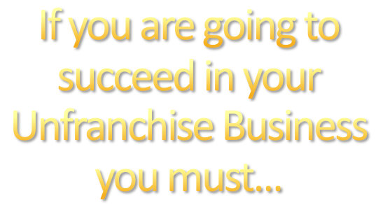



Know the Market America Business Better
  Understand the concepts and logic
  You need to be in better shape
        More repetition
      More consistency
  You need to be the “Go Now” in your organization

Slide 108
2. Step Up and Be a Professional
  You must live in your house
    Under promise and over deliver
    Edify your team mates
    No personal agendas

Slide 109
2. Step Up and Be a Professional
  Do not quit in the middle
    Run the distance
    Follow through
  Pay attention to details
  Give recognition based on “established parameters”

Slide 110




Slide 111


New Distributor Growth Strategy
Experience Residual Income
Validate The System
Build Belief
Confidence to Lead

Slide 112
New Distributor Growth Strategy
Learn to Follow
Walk the Talk
Walk in Your Team’s Shoes

Slide 113

New Distributor Growth Strategy
Re-enforce Your Beliefs
Repetition Leads to Consistency
Lead

Slide 114

A qualified and active Unfranchise owner who has made the commitment to “master” the UnFranchise® Business Development System by implementing the established tasks, activities, and practices as set forth and defined in the Master UFO Program.

Slide 115

A structured system that defines and tracks what components successful Market America UFOs have implemented to achieve UnFranchise® Business success.

Slide 116
SYSTEMS...
Do not guarantee success, but improves your chances significantly. You will win more than you lose. You stay longer in the game and when you stay longer in the game, your odds to win go up!

Slide 117


Complete the Shopping Assessment
Have a Subscription to UFMS
Purchase a Total of 1500 BV of Product within the Respective Quarter from your Paying Unfranchise ID or from Personally Sponsored Preferred Customers

Slide 118
Generate a minimum of NT$47,500 worth of Partner Store purchases between you and your Preferred Customers
Sponsor a minimum of one Qualified Unfranchise Owner
Attend or conduct one New Unfranchise Owner Training and Basic 5 Training

Slide 119
Attend or Conduct one Executive Coordinator Certification Training per Year
Purchase three tickets to your National Convention or Leadership school (Can be World Conference or International Convention)

Slide 120
Score greater than or equal to 50% on the Basic Five Diagnostic Test
Or earn a minimum of $900 in BV/IBV Commissions from one Business Development Center (BDC) in the qualifying calendar quarter

Slide 121


Slide 122

Residual Income
Provides the answers to:
    What do I have to do to be successful?
    How much money can I earn?
Validates Leadership
Increase Distribution
Recognition
Build your Business to Last

Slide 123


Slide 124
MASTER
UFO PROGRAM
Notes:
124

Slide 125
YOU
Accrued GIBV Totals
Accrued GIBV Totals
5000 IBV
IBV
BV
BV
IBV
5000 IBV
3600 IBV
IBV
BV
BV
IBV
3600 IBV
2400 IBV
IBV
BV
BV
IBV
2400 IBV
1200 IBV
IBV
BV
BV
IBV
1200 IBV
HP
Motives
Motives
NC
Transitions
NC
H & N
Internet Shopping
OPC-3
Web
OPC-3
Motives
OPC-3
Personal Care
Internet Shopping
NC
OPC-3
H & N
NC
Motives
HP
Recruiter
HP
Personal Care
Web
Anti-Aging
Transitions
Web
Recruiter
HP
Anti-Aging
Web
Notes:
Talking Points
Have already developed Distributors with customers, now have customers use Web Portals
Provide Endless Shopping Experience™ through Web Portals
Build strong relationships with customers on a one-to-one basis
Sustain dialogue and obtain feedback with and from Preferred Customers to identify what they want and need
Sell existing customers more products/services (within the product line, within the store, within the Mall, within the Partner Stores)
Increase profitability and security
Selling more products to fewer people is more efficient and more profitable than the time honored mass-marketing rules of pitching products to the greatest number of people

Slide 126


Slide 127

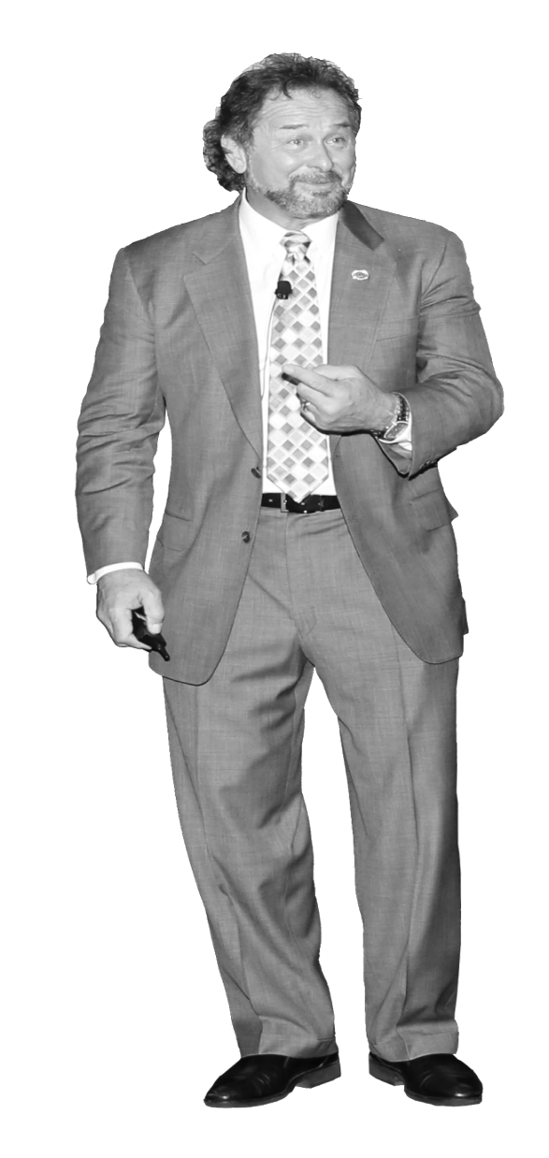
SETTING
a WINNING MINDSET
You cannot sail the ship on yesterday’s wind.

Slide 128
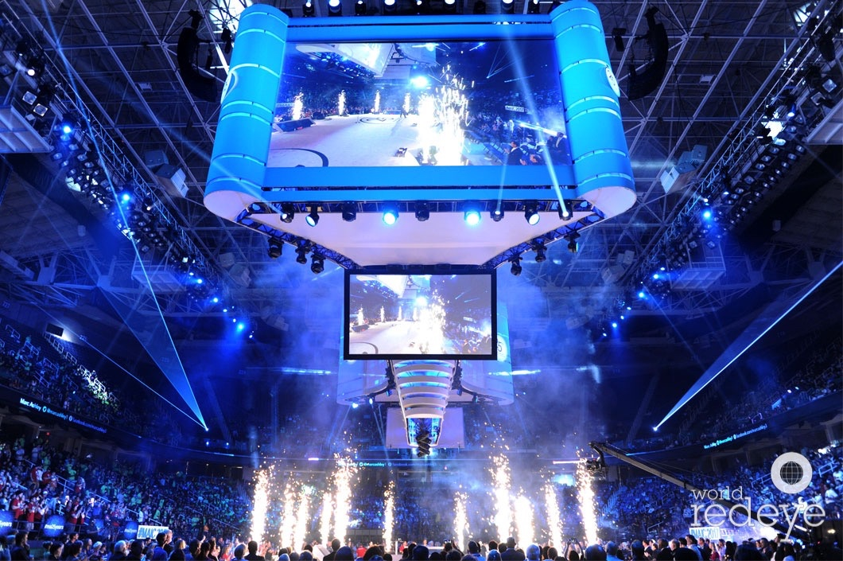
Every new UnFranchise Owner experiences three major phases of our UnFranchise Business.

Slide 129

HOPE...
That the UnFranchise Business Presentation works and can make the difference for accomplishing their goals.

Slide 130
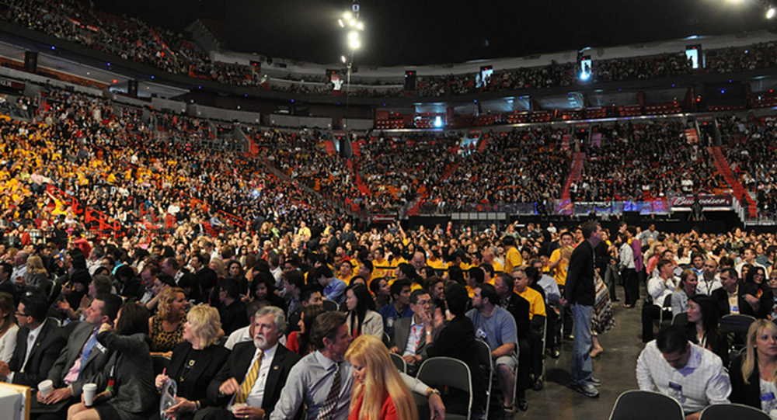
FAITH...
Meeting UnFranchise Owners who have succeeded in building a meaningful income validates that the UnFranchise Business and the Management Performance Compensation Plan (MPCP) works.

Slide 131

BELIEF...
Accomplishing the steps necessary to achieve success in their own UnFranchise Business. (takes 4-6 months)
  Being a product of the product and building their Shopping Annuity
  Retailing a ma Branded Product and experience a repeat sale
  Personally Sponsor their first UnFranchise Owner

Slide 132
BELIEF...
Accomplishing the steps necessary to achieve success in their own UnFranchise Business. (takes 4-6 months)
  Activating their Business Development Center (BDC)
  Earning their first commission check
  Attending their first major event

Slide 133

Set Your Course...
Establish Your Goals and Write Them Out
  Your goals must be set by you
  Your goals must be compelling enough to make you move
  Your goals should have completion date
  Include short and medium-term goals
  Set your action plan to meet your time line
  Break them down in daily, weekly and monthly goals
If you aim at
nothing... you will
hit it!

Slide 134

What is Mindset
Mindset is the established set of attitudes held by someone
A collection of thoughts and beliefs that shape your habits
A characteristic in which you respond to a situation

Slide 135

Mindset Objectives
To Remove Obstacles
Excel in Performance
Establish A Baseline of Production
Develop Your Potential
Become A Professional Networker, Build Relationships Daily
Master Your Story
Identify and Focus on the Big Rocks
Eliminate the Distractions
Keep the End in Mind
Create Urgency
Be Dynamic like the Business...Analyze, Adapt and Achieve
Time Management

Slide 136

Create a
SUCCESS
environment!

Slide 137

Set Each Day To Succeed
Create a list
Set your schedule and let it be known...learn to say NO
Eliminate the distractions and temptations
Implement the 5-second rule; stop the procrastination

Slide 138

Prepare to leave your comfort
zone; learn to sacrifice to accomplish your goals.

Slide 139

Discomfort often times becomes the best teacher. If it feels good, are you pushing hard enough?
Examine the outcomes.

Slide 140

RESET your negative thoughts. We all experience SETBACKS and BAD DAYS.
Notes:
Will this work for me? No one will work with me?
Can I answer the tough questions?
What will my friends think of me?

Slide 141
Will this ever work for me?
What do my friends and family think?
Is this really something different?
Wonder if anyone will work with me?
Do I have the skills to succeed?
My spouse is so negative, maybe they are right.
Notes:
Will this work for me? No one will work with me?
Can I answer the tough questions?
What will my friends think of me?

Slide 142

DO NOT UNDERESTIMATE self talk. Learn to overcome those negative thoughts.

Slide 143

Overcome your BIGGEST CRITIC...YOU! Start giving yourself credit for the out-of-the-norm performances. You are so much more than you think.

Slide 144


POSITIVE AFFIRMATIONS set the stage for overcoming those times of doubt.

Slide 145

...!
GIVE UP short-term mindset!

Slide 146

Overcome the
NAYSAYERS.
If it was easy, everyone would do it!

Slide 147
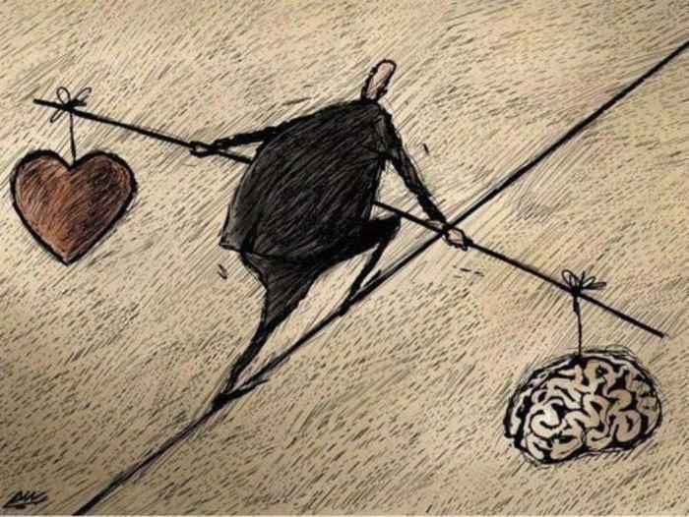
Balance Your Emotions With Logic
Too much of any one thing is not good. You
can’t live on emotions , and you can’t live life, if you only use logic.

Slide 148

THE GUT FEELING...
that we sometimes act upon is based on things that make sense and include both emotion and logic. You will never be right all the time, but you can be right most of the times.

Slide 149

Every goal should be complimented with a purpose. Be PURPOSE DRIVEN.

Slide 150

To compliment your goals, determine your MISSION. Write a clear and concise Mission Statement about what you want to accomplish. Your PURPOSE needs to attract others.

Slide 151

To engage, enlighten, educate, and empower
entrepreneurs to
creating both physical and financial health.
Sample
Mission

Slide 152

UNDERSTAND your failures and LOSE the excuses.

Slide 153
Every success story come with failures. If you accept responsibility for your success, you will embrace your failures.

Slide 154
Look to understand your outcomes, good or bad. You CAN or you CAN’T. YOU ARE RIGHT!
BE RESOURCEFUL!

Slide 155

Jump into the FIRE at least once a day!
Challenge yourself daily. Speak the truth and maintain your veracity. Don’t avoid the TOUGH jobs. Embrace them. There is always something to learn from those difficult tasks or situations.

Slide 156
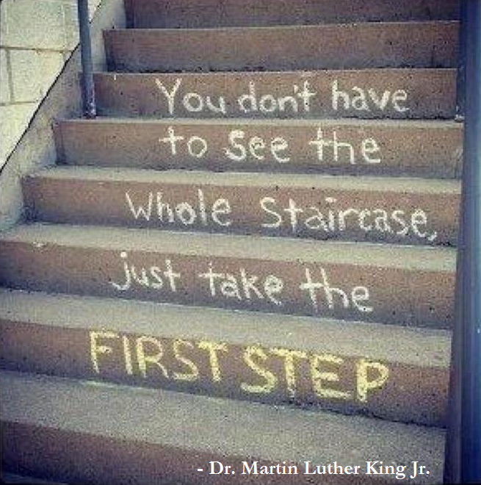
Taking the FIRST STEP is always the hardest step. The second, third and fourth are just as hard. The fifth, sixth, and seventh becomes tolerable. The longer you go, the easier and before you know it...is complete.

Slide 157

Everything improves once you address and overcome the challenges of the day!

Slide 158

Are you intimidated?
or
Do you EMBRACE it?

Slide 159

Give up playing small...take full ownership
What is the difference between 10,000 and 100,000
It is up to you to set the stage. People play to their expectations?
Do not underestimate your ability. Play to your potential!

Slide 160

Give up on your need to be liked!
This kind of thinking keeps you from being who you are!

Slide 161


Will these people exchange their place with yours?
People who like you will love you when you speak your mind!

Slide 162

Exchange the TOXIC people in your life with people who are WINNERS!
Define what a winner is...
They say...you become what your 5 closet friends or partners you hang out with!

Slide 163

Experience has taught me that any individual’s success is most often influenced by the leadership provided.
When you lead, be mindful of what you put into motion!

Slide 164

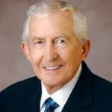
Goal setting sets up the motivation for recognition.
Think meritocracy...the right performance counts
Remember the “compounding effect”.
“To achieve wealth in a business, always look for the multiplier”.
- Paul J Meyers

Slide 165

be an
INFLUENCER

Slide 166

Leave everything better than you found it.
Be a GIVER.
Make a strong first impression.

Slide 167

FAILURE and DISAPPOINTMENT are two of the MOST USEFUL resources for an entrepreneur.
Why, besides the lessons and experiences? These take you to a crossroad where choices are essential to move forward.

Slide 168

Your organization can GROW only to the extent that you do!

Slide 169
Purchase 3 tickets to the next GMTSS Event
Sell and personally use 500 BV
Make 4 purchases on Shop.com
Show the Plan 8 times and follow up
30-Day Mindset Mentoring

Slide 170
WEEKLY UPDATES
Business Volume Purchased
Shop.com Purchase
Plan and Prospect Name
  Name/Date/Approach
  Interested Level (1-5)
What Follow Up

Slide 171
What do you want
Why do you want it
Vetting your vision
Results producing activities
Keeping your energy high
Names list strategy
Time management
Ways to show The Plan
DAILY TRAINING TOPICS

Slide 172
Turning a conversation into an approach
Follow up with a prospect-interested / not interested
Measure, Monitor, Adjust and Control
How to ask for the money
Impact selling
Conquering fear
MONTHLY TRAINING TOPICS

Slide 173
MONTHLY TRAINING TOPICS
Speaking the truth veracity
Putting pep in your step
Working through the tough times
Leadership or Management
Where do we go from here

Slide 174

SETTING
a WINNING MINDSET

Slide 175

Success Is A Choice
There has never been a better time to grow than now.

Slide 176

Corporations
DO NOT HAVE
CONTROL
TODAY...
  Information is available to all
  Capital can be raised through crowd sourcing
  Talent is sourced from around the world
  Advertising through social media and per click pay
  Distribution is accessible by all direct to the market

Slide 177

SUCCESS is something you pay for in advance.
Payments will be in emotional strength
You need training to enhance skill set
Overcome self-doubt

Slide 178
SUCCESS is measured by the obstacles you overcome.
Rejection
Failures
The number of work corrections
Financial
Competition
Leadership

Slide 179

Keep looking up and never look back.
Do not doubt yourself or be overcome with fear.

Slide 180

SMALL STEPS
results in big accomplishments
FOCUS on the results-producing activities.

Slide 181

WIN
the day!

Slide 182

Make a statement to stay in the game.

Slide 183

Do something positive your business.
CONSISTENCY and EXECUTION!

Slide 184

BELIEVE TO ACHIEVE
Believe in yourself, your team, your products, your plan and your company!

Slide 185

You CAN and WILL achieve great things.
Make a DECLARATION...the DECISION to WIN!

Slide 186

SUCCESS is never permanent.
It is a platform to accomplish more!

Slide 187

THE VICTOR’S CODE
  Seven timeliness universals
  Teach them early what we have learned late
  Learn it, internalize it, live by it

Slide 188

VISION
/vi-zhun/
The ability to see.
Notes:
The ability to see. See so much more than what others see. Taking the dream from fantasy to formulating the path to move closer to reality. Taking a flashlight beam of light to a laser light

Slide 189

val·or
/ˈvalər/
Possessing exceptional courage and determination.
Notes:
The courage to begin the formation of the vision, taking the first step of a 1000 mile journey. The commitment to put in the work necessary to accomplish set goals. The courage to admit fault, to over come fear.

Slide 190

“The Spartans do not ask how many are the enemy, but where they are.”
- Plutarch
Notes:
The confidence in the discipline and execution of what you have trained to do. Spartans were training from birth to be great fighters. One who looks at opportunity where others do not. To accomplish victory one must prepare and engage to win the desired outcome.

Slide 191

ve·he·mence
/ˈvēəməns/
Showing of great energy
or passion.
Notes:
The words of find a calling that you love and you will never work a day in your life. Passion is a driver, and fountain of endless energy to stay the course. It is the fuel that allows you to maximize your potential, or stretch your commitment. We loved playing football at every level, however to play on the big stages you had to be vehemently committed to do the activities that it takes to get you there. This is where you insert the results producing tasks of any profession

Slide 192

ve·rac·i·ty
/vəˈrasədē/
The habit of speaking the truth.
Notes:
You can not go in a set direction and speak to another. Your message becomes weak and misguiding. You pain illusions rather then realities. Whether a person likes you or not, one can not change that first impression without an enormously amount of work. Speak the truth and you will save time, disappointment and improve your results.

Slide 193

vi·tal·i·ty
/vīˈtalədē/
The life force or ability to live.
Notes:
Enjoy the benefits of a clear mind and fit body. Recognize the physical challenges that a journey can inflict ad condition the body to withstand those tests. We are made to physically move/work and consistently testing oneself will move you to better levels of performance. Life is about living, performing and experiencing. . It is about nurturing and growing throughout your life.

Slide 194

vig·or
/ˈviɡər/
The ability to thrive
and survive.
Notes:
What is happening in this photo. Searching for clarity, emptiness, how did I get hear, what path should I take now. What is really really really important to me, who do I represent, why have I taken this road, I can always do something else. How do I respond when my confident talk has been tested. Am I willing to take set backs and move forward. This road is long and is it really worth the pain
Need to find out what fight this picture was taken from and what did the picture depict in the outcome of the fight.
Over come the naysayers, to accept and move forward when met with setbacks or challenges.

Slide 195

vic·to·ry
/ˈvikt(ə)rē/
The accomplishment of an aim.
Notes:
Vision to Victory, the arrival, of setting out to do something and reaching that reality. What does it all mean. I did it, I set out to make something happen and I achieved my last laugh. I find it a time to step back and smell the coffee, but it is also a platform to see a bigger picture to set new visions.

Slide 196

“The harder the battle, the sweeter the victory.” - Unknown

Slide 197

"There will never be 'the right time in your life to do a great thing. You must create that time and greatness will follow."
- John A. Passaro

Slide 198

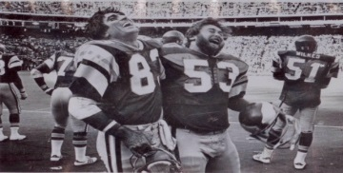
the
Victor’s
code

